Slide 1
Invoice Management Application
Group - 9
Anshul Kuncha
Rohit Kota
Kavya Kishore Mudumbai
Nitish Sindiri
Viraj Shah

Slide 2
Invoice Management Predictions
This application has been developed for businesses with a focus on improving the efficiency of their account receivable department. Specifically, it is designed to help B2B organizations keep track of their customers' account clearance dates.
As part of their regular operations, seller businesses engage with various other businesses and sell them goods at different times. To ensure proper accounting, the seller needs to monitor all the invoices from the buyers, which include details such as payment due date, invoice date, invoice amount, baseline date, and other relevant information.
The purchasers are required to clear the payable amount before the due date, but in reality, invoices are not always paid in full by the due date. The payment date, which refers to the date on which a customer pays the invoice, can vary. The application helps to track payment dates to ensure accurate account receivable management.

Slide 3
Accounts Receivable
Accounts Receivable refers to the amount of money owed by customers to a business for the products or services sold on credit. Typically, an invoice is generated for each sale and sent to the customer either by mail or electronically. The customer is then required to pay the invoice within a set timeframe, which is determined by the agreed credit terms or payment terms.
In a perfect world, buyers would pay their invoices within the agreed-upon timeframe (the Payment Term). However, it is common for buyers to miss this deadline, and this is where the Account Receivables Department becomes necessary.
Every business has a dedicated Account Receivables Department responsible for managing and tracking the payment of invoices.
The Account Receivables team is responsible for:
Collecting payments from customers who have past due invoices
Sending reminders and follow-ups to customers who have outstanding payments
Managing the entire process of receiving cash inflows
Ensuring that the company is paid for the services and products it has provided

Slide 4
Objectives of the Project
Pre-processing the collected dataset.
Feature Engineering on pre-processed dataset.
Building a Predictive Model to forecast the payment date of an invoice.

Slide 5
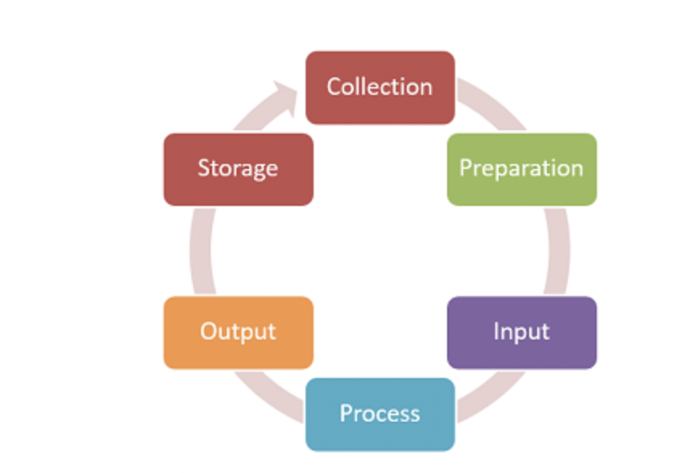
Data pre-processing
Dealt with null values
Formatted data into proper order
Omitted duplicate data
Modified currencies
Sorted dates in the data-frame.

Slide 6
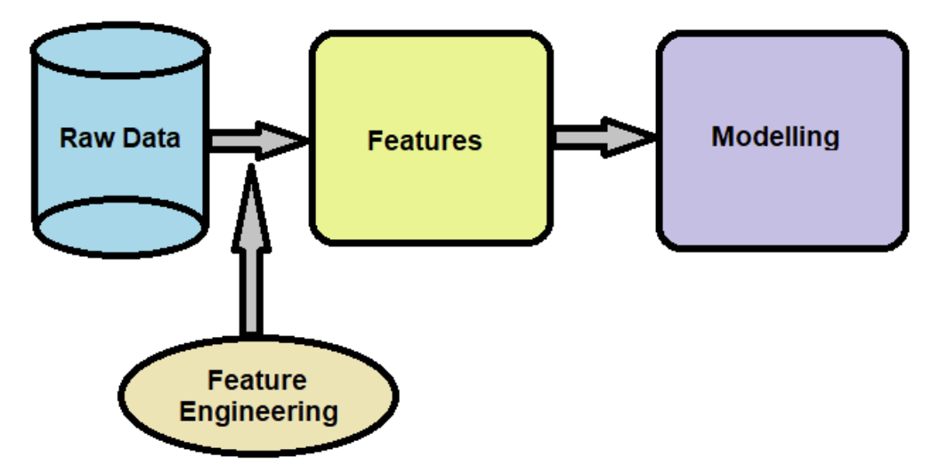
Feature engineering
Feature engineering is a machine learning approach that involves utilizing data to generate new variables that do not exist in the original training set. It can be applied to both supervised and unsupervised learning, with the aim of simplifying and accelerating data transformations while also improving model accuracy. Feature engineering is a crucial step in machine learning modeling, as the quality of the features can directly impact the performance of the model. Even with the most advanced data and architecture, a poorly engineered feature can have detrimental effects on the accuracy of the model.
Feature Creation
Exploratory Data Analysis
Feature Extraction

Slide 7
Building a Model
Based on the previous payment patterns, the ML model needs to predict what will be the date a payment is made by the customer for an invoice. The model also needs to predict which aging bucket the invoice falls into based on the predicted payment date.
To do so, we have incorporated three Models Viz:
Decision Tree
Linear Regression
Random Forest
We have obtained highest results of metrics for Random Forest than the other two models, as it includes important features.
After performing EDA on the dataset, we’ve applied feature transformation – Boxcox, Log based, Square root; post which we’ve observed that the boxcox transformation has shown the best result. Later, we have used tree-based model to select further significant features/ parameters.
We noted that the performance indicator has improved after performing the above steps.

Slide 8
THANK YOU

